Slide 1
Student Guide to Online LARC Services
Online Tutorial Program and Writing Center Tutoring
Online Supplemental Instruction & Stretch Math Learning Communities.

Slide 2
LARC Program Update
*For 2021-22, LARC programs and services are available BOTH in-person and Online through Zoom. Tutoring appointments for the Tutorial Program (subject-specific tutoring) and the Writing Center can be made through your Student Portal using the LARC-WC Online Tile. Students can choose the modality of their tutoring session and they will receive a confirmation email with instructions for accessing their online Zoom tutoring session.
If you have Supplemental Instruction or a Learning Community attached to your course, please check your email and Canvas page for announcements about sessions. Your SI Leader or Learning Community Mentor (LCM) will email you instructions on how to access sessions.
Questions or Assistance? Contact: larcdeskw@sonoma.edu

Slide 3
This Student Guide to Online LARC Services covers...
Online Subject-specific & Writing Tutoring
Online Supplemental Instruction & Stretch Math Learning Communities
Click the links on the side to jump to that section of the guide!

Slide 4
Online Subject-specific & Writing Tutoring
How to access and navigate your Zoom tutoring appointments.

Slide 5
In this section, we’ll cover….
Tutorial Program & Writing Center Services
How to schedule a tutoring appointment
Getting ready for your Zoom tutoring appointment
Zoom Tips & Tricks
Click the links on the side to jump to that slide!

Slide 6
The Tutorial Program offers free peer tutoring in over 50 courses each semester, as well as computer science embedded lab tutoring.*
Our peer tutors adjust their tutoring to your learning preferences. They can help you review course content, develop study skills, and increase your confidence as a student.
The SSU Writing Center strives to be a vibrant, welcoming academic service for all writers at Sonoma State University. Peer Writing Tutors can help you with any writing task at any stage of the writing process.
Students enrolled in 99t sessions will be able to meet their requirement through either in-person or Zoom tutoring appointments.

Slide 7
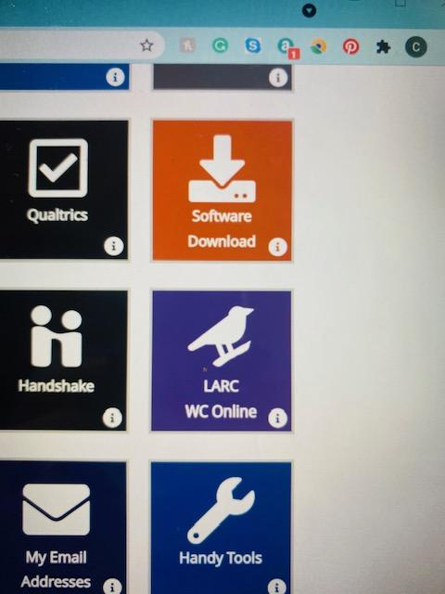
The First Time you click the LARC-WC Online Tile
Click the purple LARC tile in your Student Portal.
You will be prompted to register for an account with WC Online. This is our scheduling system.
Please fill in all fields. You will be asked for you Student ID#, major, telephone number.
We also recommend that you keep the defaults so that you get email reminders about your tutoring appointments.
You can also set up text message reminders.

Slide 8
Making a Tutoring Appointment
Click the Purple “LARC-WC Online” tile in your Student Portal.
Select "Writing Center" or “Tutorial Program” from the top drop-down menu.
Select the course you need tutoring for, if scheduling with Tutorial Program (ex: Math 165).
Click on a white space to make an appointment on a day and at a time that works for you. Pick a session that matches the modality you want, whether that is in-person or over Zoom.
Choose the appointment length (30-60 minutes).
Fill in all the fields to Llet the tutor know what you will be working on.

Slide 9
Screenshot of the Schedule

Slide 10
Screenshot of the appointments
Note: Students won’t see all the colors. YOUR personal appointment will be YELLOW.
White Slots = OPEN APPOINTMENTS!

Slide 11
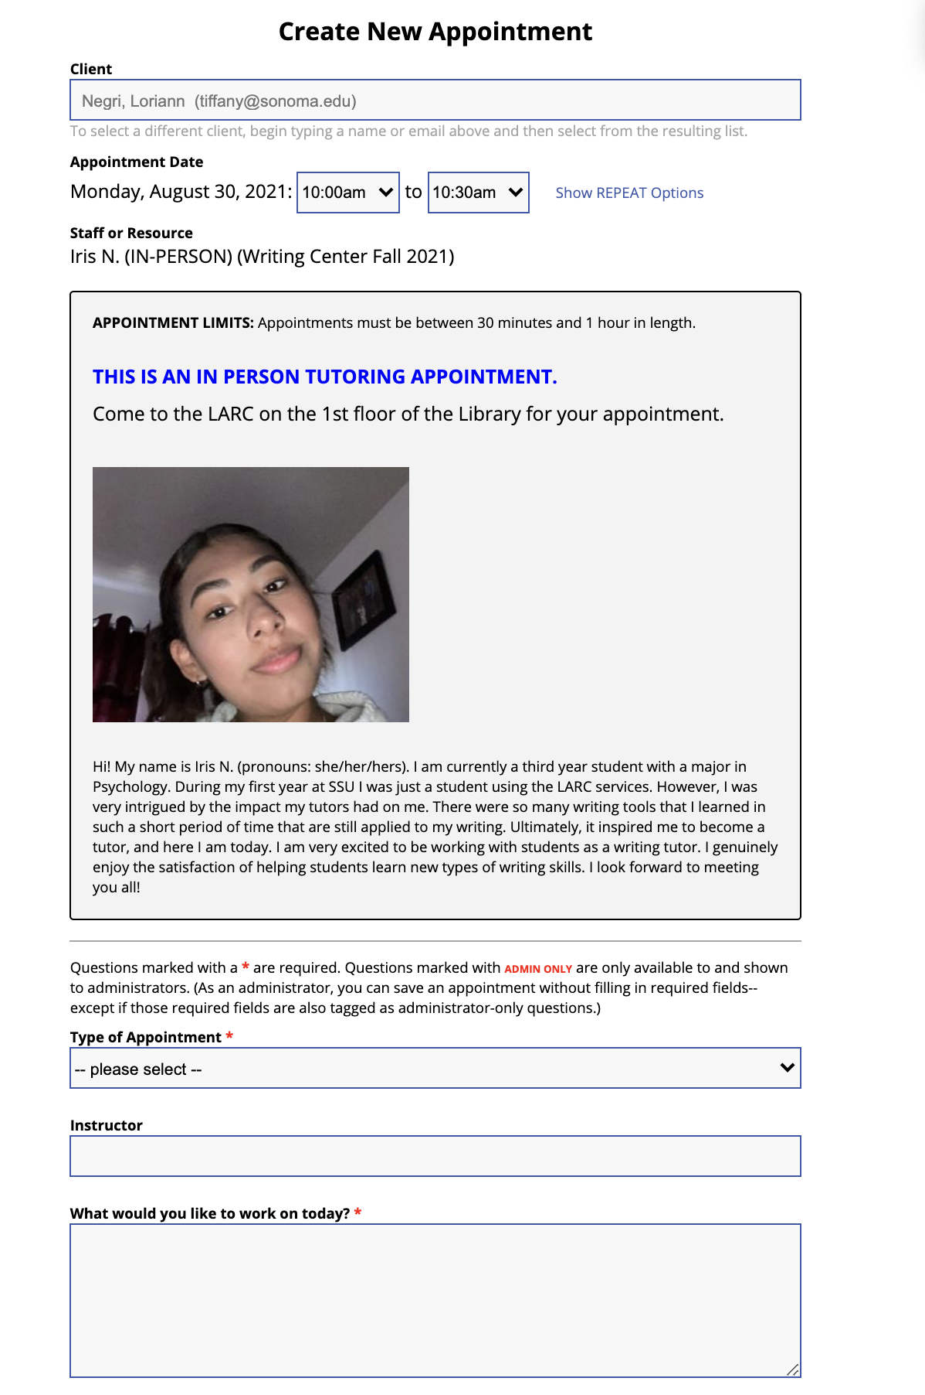
Screenshot of the appointment window
This is only a partial screenshot. There are more questions in the pop up window and a large blue button that says “Create Appointment” that confirms your appointment. You will also get an email confirmation.

Slide 12
Helpful Hints:
Read the tutor profile at the top of the appointment window OR on the LARC Tutor Profiles page. This will help you select a tutor that meets your specific needs.
Make a note of the day, time, and tutor name for your appointment, and which modality it is in. You will get an email reminder as well if you select that option when registering for an account (highly recommended).
The Zoom meeting link is in your appointment on WC Online. For in-person appointments, please come to the LARC on the first floor of the University Library, Schulz.
I’ve scheduled my online appointment, now what?
Please log into your WC Online account through the LARC-WC Online Tile in MySSU and select the appropriate schedule and click on your appointment link 5 minutes before your session: The Zoom meeting link is in your appointment on WC Online.

Slide 13
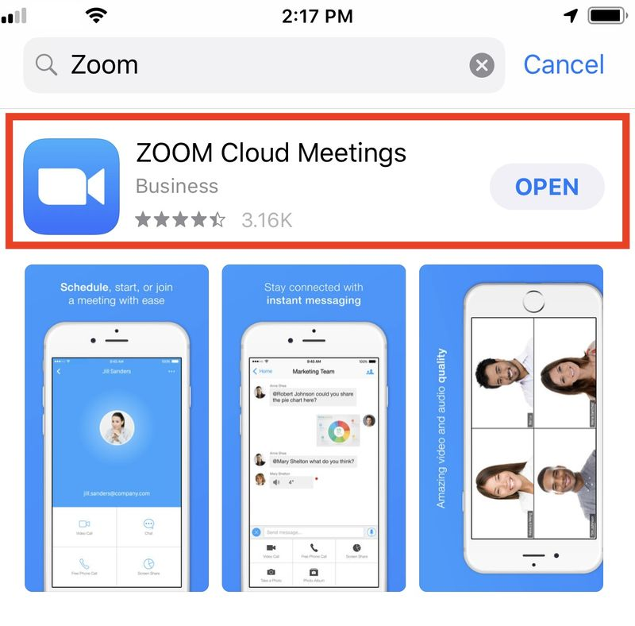
Getting ready for your Zoom tutoring appointment
If you are using a laptop or tablet, you can click the link and join the meeting. If you are using a phone, you will first need to download the Zoom app on your phone, so allow some extra time for this step.

Slide 14
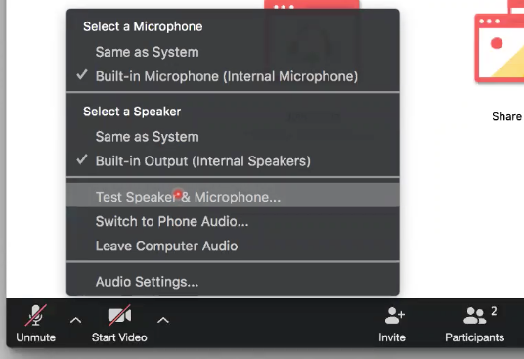
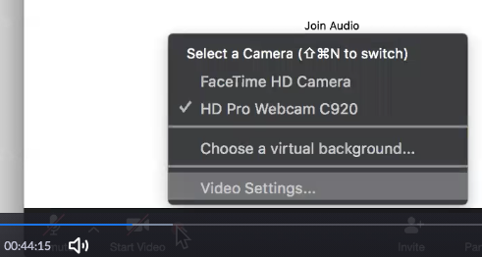
Starting your online session (continued)
Test your speakers & microphone, by clicking the audio settings in the bottom left corner.
Test your video settings, by clicking the “start video” icon in the bottom left corner.

Slide 15
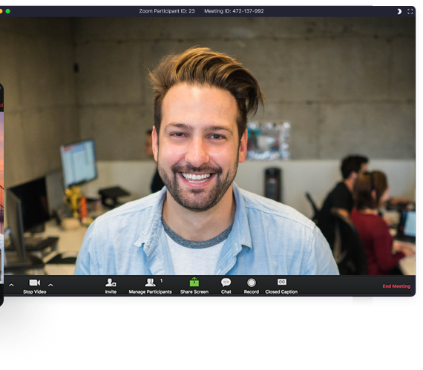
Zoom Tips & Tricks
Turn your video on so your tutor can see you.
Other helpful hints for set up and checking video/sound quality:
Choose a location with good lighting.
Choose a location with relatively no to low background noise (if possible).
Having trouble with the sound? Use the chat feature to communicate with your tutor.

Slide 16
Online Supplemental Instruction & Stretch Math Learning Communities
How to attend Zoom SI or Learning Community Sessions.
Note: Some SI and Learning Communities are being held in-person for Fall 2021. Check with your instructor or Course Canvas to confirm.

Slide 17
In this section,
we’ll cover….
Courses that have SI Sessions or Math Learning Communities.
How to join a Zoom SI/LC Session
Zoom Session FAQs & Tips
Click the links on the side to jump to that slide!

Slide 18
Courses supported by SI or Math Learning Communities
Click this link to view a complete list of supported courses & session time offerings. Zoom session meetings should be the same time as your regularly scheduled SI/LC session, but please be on the lookout for email and/or Canvas communication from your SI Leader or Learning Community Mentor for online session updates and changes.
Don’t see your course? Schedule a tutoring appointment!

Slide 19
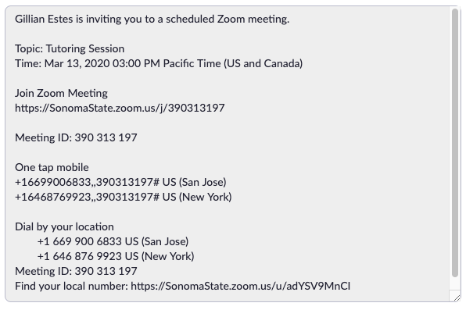
How to join a Zoom SI/LC Session
Be on the lookout for a Canvas announcement or Email with an invitation to join the session. Click the URL. If you are using a laptop or tablet, you can click the link and join the meeting. If you are using a phone, you will first need to download the Zoom app on your phone, so allow some extra time for this step.
Your SI Leader/LCM will spend the first few minutes

Slide 20
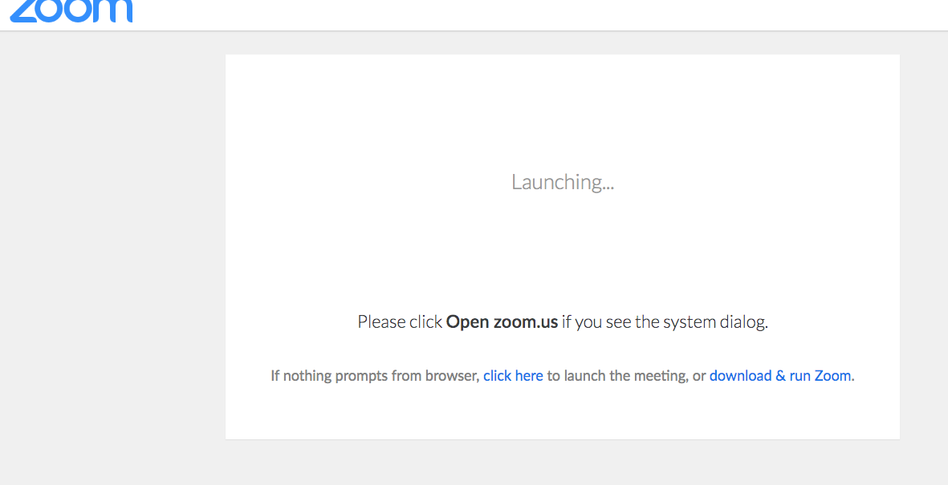
Joining your online session (Zoom meeting)
Now, you should see the window below pop up. If nothing prompts from your browser, select “click here.”

Slide 21
Starting your online session (continued)
Test your speakers & microphone, by clicking the audio settings in the bottom left corner.
Test your video settings, by clicking the “start video” icon in the bottom left corner.

Slide 22
Zoom Tips & Tricks
Turn your video on so other students can see you.
Other helpful hints for set up and checking video/sound quality:
Choose a location with good lighting.
Choose a location with relatively no to low background noise (if possible).
Having trouble with the sound? Use the chat feature to communicate with the SI Leader/LCM.

Slide 23
Zoom Session FAQs & Tips
I can’t access/attend online sessions, can I have a recording of the session?
The SI Leader/LCM will provide recordings or session materials whenever possible, please contact your SI Leader/LCM via email.
Will my professor be in the Zoom meeting?
No. Zoom sessions are instructor free zones, where you can ask questions and make mistakes in a peer-to-peer environment.
Need help with Zoom? Your SI Leader/LCM will walk you through how to use various features, you can also check out Zoom’s website.

Slide 24
Questions?
The LARC is here to support you throughout your academic career. Please contact the larcdeskw@sonoma.edu with any questions or concerns.

